Slide 1
OOPs with JAVA by Mohammed Yahya usn: 3PD23CS076

Slide 2
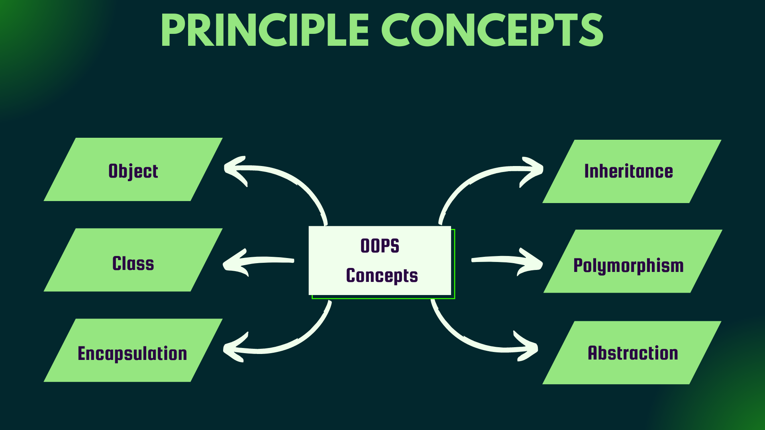

Slide 3
Object-Oriented Programming Paradigm (OOP): A New Programming Approach
Introduction to OOP as a New Paradigm
The evolution of programming has seen significant milestones, starting from procedural programming to structured programming, and now, Object-Oriented Programming (OOP).
OOP addresses the limitations of earlier paradigms by introducing a model that mirrors real-world objects and relationships.

Slide 4
Evolution of Programming Paradigms
Procedural Programming: Focused on sequences of instructions, often leading to complex and rigid codebases.
Structured Programming: Introduced modularity, enhancing code readability and reusability.
Object-Oriented Programming: A paradigm shift that emphasizes objects and their interactions, promoting flexibility and scalability.

Slide 5
Structured vs. Object-Oriented Development
Structured Development: Based on functions and control structures, where data and behavior are treated separately.
Object-Oriented Development: Centers around objects and classes, encapsulating both data and behavior in cohesive units.

Slide 6
Key Features of Object-Oriented Programming
Objects and Classes:
Objects: Represent real-world entities with attributes (data) and methods (behavior).
Classes: Blueprints that define the structure and behavior of objects.
Multiple Views of the Same Object:
Objects can be viewed differently depending on the context, enhancing flexibility.

Slide 7
Encapsulation and Data Abstraction:
Encapsulation ensures data is hidden from unauthorized access.
Abstraction focuses on essential characteristics, hiding complex details.
Inheritance:
Enables new classes to reuse and extend existing classes, promoting code reusability.

Slide 8
Delegation (Object Composition):
Combines objects to achieve functionality without relying solely on inheritance.
Polymorphism:
Allows objects to be treated as instances of their parent class, supporting flexibility in method usage.

Slide 9
Introducing Data Types and Operators in Java
Java Primitive Types and Literals
Java provides a variety of primitive types, such as int, float, char, and boolean.
Literals: Fixed values assigned to variables, like 123 for integers or 'A' for characters.
Variables: Scope and Lifetime
Variables have scope (visibility) and lifetime (existence duration), critical for memory management.

Slide 10
Operators in Java
Arithmetic Operators: Perform basic mathematical operations (+, -, *, /, %).
Relational and Logical Operators: Compare values and manage logical conditions (>, <, &&, ||).
Short-Circuit Logical Operators: Efficiently evaluate conditions using && and ||.
Assignment Operators: Assign values (=, +=, -=).

Slide 11
Type Conversion and Operator Precedence
Type Conversion: Converts variables from one type to another, using explicit casting if necessary.
Operator Precedence: Determines the order in which operators are evaluated in an expression.

Slide 12
String Handling in Java
Fundamentals of Strings
Strings in Java are immutable sequences of characters, managed by the String class.
Constructors and Methods
String Constructors: Allow strings to be initialized in various ways.
Key Methods:
length(): Returns the number of characters in a string.
indexOf() and lastIndexOf(): Locate characters or substrings.

Slide 13
Conclusion
Object-Oriented Programming represents a robust paradigm shift, offering solutions to the limitations of earlier programming models.
Java, with its strong support for OOP and efficient string handling, serves as a versatile tool for modern software development.
Mastering these foundational concepts paves the way for building scalable and maintainable applications.

Slide 14
More Data Types and Operators in Java
Arrays and Multidimensional Arrays
Arrays:
Arrays are collections of data elements of the same type, stored in contiguous memory locations.
Declared using syntax: type[] arrayName; or type arrayName[]; (alternative syntax).

Slide 15
Multidimensional Arrays:
Arrays with two or more dimensions, often used for matrices.
Example: int[][] matrix = new int[3][3];.
Key Features:
Assigning Array References: References can be reassigned to arrays of compatible types.
Using the length Member: Provides the number of elements in an array.
For-Each Loop: Simplifies iteration over array elements.

Slide 16
Strings
Strings are immutable sequences of characters, handled using the String class.
Bitwise Operators
Perform operations on binary representations of integers.
Examples: & (AND), | (OR), ^ (XOR), ~ (complement), and shift operators like <<, >>, >>>.

Slide 17
Introducing Classes, Objects, and Methods
Class Fundamentals
A class is a blueprint for objects, encapsulating data (fields) and behavior (methods).
Object Creation and Reference Variables
Object Creation: Done using the new operator. Example: MyClass obj = new MyClass();.
Reference Variables: Store the address of an object and allow access to its members.

Slide 18
Methods
Defined blocks of code that perform specific tasks.
Returning from Methods: Methods can return values or be void.
Using Parameters: Pass data to methods via arguments.
Constructors
Constructors: Special methods for initializing objects, automatically called during object creation.
Parameterized Constructors: Accept arguments to initialize object attributes.

Slide 19
Key Concepts
The new Operator: Revisited for memory allocation during object creation.
Garbage Collection: Automatic memory management by removing unused objects.
The this Keyword: Refers to the current object instance, often used to differentiate between instance variables and parameters.

Slide 20
A Closer Look at Methods and Classes
Controlling Access to Class Members
Use access modifiers (private, protected, public) to define visibility and encapsulation.
Passing and Returning Objects
Objects can be passed as arguments and returned from methods, enhancing modularity.
Method Overloading and Constructors
Method Overloading: Defining multiple methods with the same name but different parameter lists.
Overloading Constructors: Providing multiple ways to initialize an object.

Slide 21
Understanding Static
Static methods and variables belong to the class rather than any object, accessible without creating an instance.
Nested and Inner Classes
Nested Classes: Declared inside another class, can be static or non-static.
Inner Classes: Non-static classes defined inside a class, have access to the outer class's members.

Slide 22
Conclusion
Java’s data types, operators, classes, and methods form the foundation of efficient programming.
Mastering advanced features like nested classes, recursion, and method overloading enables writing clean, modular, and reusable code.
Understanding these concepts is crucial for solving real-world problems with Java.

Slide 23
Inheritance
Basics of Inheritance
Definition: Inheritance allows a class (subclass) to acquire properties and methods from another class (superclass).
Promotes code reusability and supports hierarchical classification.
Syntax: class Subclass extends Superclass.
Member Access and Inheritance
Subclasses inherit public and protected members of the superclass.
Private members are not directly accessible, but can be accessed via public/protected methods.

Slide 24
Constructors and Inheritance
Constructors: Not inherited but can be invoked using the super keyword.
Using super:
To Call Superclass Constructors: Ensures proper initialization of superclass members.
To Access Superclass Members: Resolves naming conflicts between superclass and subclass.

Slide 25
Advanced Features
Abstract Classes:
Classes declared with abstract keyword cannot be instantiated.
Used to define a common base with some methods implemented and others left abstract.
Using final:
Prevents a class from being extended or a method from being overridden.
The Object Class:
The root class of all Java classes, providing methods like toString(), equals(), and hashCode().

Slide 26
Interfaces
Interface Fundamentals
Definition: Interfaces define a contract for classes to implement, specifying method signatures without implementation.
Syntax: interface InterfaceName {}.
Creating and Implementing Interfaces
Creating an Interface: Define method signatures and constants.
Implementing an Interface: A class uses implements to adhere to an interface’s contract.

Slide 27
Advanced Features of Interfaces
Using Interface References: Interfaces can be used to reference objects of classes that implement them.
Implementing Multiple Interfaces: Java allows a class to implement multiple interfaces, promoting flexibility.
Constants in Interfaces: Variables in interfaces are implicitly public, static, and final.
Extending Interfaces: Interfaces can inherit from other interfaces.

Slide 28
Packages
Package Fundamentals
Packages are namespaces for organizing classes and interfaces, preventing naming conflicts.
Syntax: package packageName;.
Packages and Member Access
Default Access: Members are accessible only within the same package.
Public Access: Members are accessible across packages.

Slide 29
Importing Packages
Use import packageName.*; to include a package.
Example: import java.util.*;.
Static Import
Allows importing static members of a class directly, removing the need for class qualification.
Syntax: import static packageName.ClassName.staticMember;.

Slide 30
Conclusion
Inheritance: Enables code reuse, supports polymorphism, and introduces concepts like super and abstract classes.
Interfaces: Provide a contract for classes, supporting abstraction and multiple inheritance.
Packages: Offer an efficient way to organize and access Java classes, improving code maintainability.

Slide 31
Exception Handling
. The Exception Hierarchy
All exceptions in Java are derived from the Throwable class.
Checked Exceptions: Must be declared in a method's throws clause (e.g., IOException).
Unchecked Exceptions: Do not require declaration (e.g., ArithmeticException).
Subclasses: Error (fatal issues) and Exception (recoverable issues).

Slide 32
Exception Handling Fundamentals
Try-Catch Mechanism:
Use try to enclose code that may throw an exception.
Use catch to handle specific exceptions.
Consequences of an Uncaught Exception
If an exception is not caught, it propagates up the call stack.
The program terminates abruptly if no handler is found.

Slide 33
Using Multiple catch Clauses
Each catch handles a specific exception type.
Example:
try {
// risky code
} catch (IOException e) {
// handle IO exception
} catch (Exception e) {
// handle general exception
}

Slide 34
Multithreaded Programming
Multithreading Fundamentals
Definition: Multithreading allows concurrent execution of two or more threads.
Benefits: Improved performance, better resource utilization, and responsiveness.
The Thread Class and Runnable Interface
Two ways to create threads:
Extend the Thread class.
Implement the Runnable interface

Slide 35
Creating Threads
Using Thread Class:
class MyThread extends Thread {
public void run() {
System.out.println("Thread is running.");
}
}
MyThread t = new MyThread();
t.start();

Slide 36
Using Runnable Interface
class MyRunnable implements Runnable {
public void run() {
System.out.println("Runnable thread is running.");
}
}
Thread t = new Thread(new MyRunnable());
t.start();

Slide 37
Synchronization
Ensures thread safety when accessing shared resources.
Synchronization Methods: Use synchronized to lock critical sections.
Synchronized Statement: Synchronize specific blocks of code
synchronized(obj) {
// critical section
}

Slide 38
Thread Communication
Methods: wait(), notify(), and notifyAll() enable inter-thread communication.
synchronized(obj) {
obj.wait();
obj.notify();
}

Slide 39
Conclusion
Exception Handling: Enables robust error management and graceful program recovery.
Multithreading: Allows simultaneous task execution, improving application performance and responsiveness.

Slide 40
Applets
Applet Basics
Definition: Applets are small Java programs embedded in a web page and run inside a browser or applet viewer.
Execution Environment: Requires Java-enabled browsers or an applet viewer for execution.
Restrictions: Applets run in a secure sandbox with limited access to system resources for safety.

Slide 41
A Complete Applet Skeleton
A basic applet structure contains the following methods:
init(): Initializes the applet.
start(): Starts or resumes the applet.
stop(): Pauses the applet.
destroy(): Cleans up resources before the applet is terminated.

Slide 42
A Complete Applet Skeleton
import java.applet.*;
import java.awt.*;
public class SimpleApplet extends Applet {
public void init() {
// Initialization code
}
public void paint(Graphics g) {
g.drawString("Hello, Applet!", 20, 20);
}
}

Slide 43
Applet Initialization and Termination
init(): Used for one-time initialization, like setting up UI components.
destroy(): Called to release resources before the applet shuts down.
Key Aspect of Applet Architecture
Applets rely on lifecycle methods (init, start, stop, destroy) and a graphical user interface framework to interact with users.
Requesting Repainting
Use the repaint() method to request the applet to redraw its content.
The paint(Graphics g) method handles the actual drawing.

Slide 44
Passing Parameters to Applets
Parameters can be passed using <PARAM> tags in the HTML code.
html
Copy code
<applet code="SimpleApplet.class" width="300" height="200"> <param name="message" value="Hello, Parameterized Applet!"> </applet>
Retrieve parameters using the getParameter(String name) method.

Slide 45
Event Handling
Two Event Handling Mechanisms
Old Event Model: Pre-Java 1.1; used handleEvent() for event processing (now obsolete).
Delegation Event Model: Introduced in Java 1.1; separates event sources and event listeners for cleaner and more modular code

Slide 46
Event Classes
ActionEvent: Represents actions like button clicks.
AdjustmentEvent: Represents adjustments to adjustable components like scrollbars.
ComponentEvent: Represents changes in component visibility or size.
ContainerEvent: Represents changes in a container, such as adding or removing components.
FocusEvent: Represents focus gained or lost by a component.

Slide 47
InputEvent: Base class for keyboard and mouse events.
ItemEvent: Represents state changes in checkboxes or other items.
KeyEvent: Represents keyboard actions.
MouseEvent: Represents mouse clicks, movements, and drags.
MouseWheelEvent: Represents mouse wheel rotation.
TextEvent: Represents changes in a text area or text field.
WindowEvent: Represents actions on windows, such as opening or closing.

Slide 48
Handling Events
Implement event listeners and override methods to handle specific events.
Example of handling an action event:

Slide 49
import java.awt.*;
import java.awt.event.*;
public class ButtonExample extends Frame implements ActionListener {
Button b;
public ButtonExample() {
b = new Button("Click Me");
b.addActionListener(this);
add(b);
setSize(200, 200);
setVisible(true);
}
public void actionPerformed(ActionEvent e) {
System.out.println("Button clicked!");
}
}

Slide 50
Adapter Classes
Simplify event handling by overriding only the required methods.
Example:
java
Copy code
class MyMouseAdapter extends MouseAdapter { public void mousePressed(MouseEvent e) { System.out.println("Mouse pressed!"); } }

Slide 51
Inner Classes and Anonymous Inner Classes
Inner classes can be used for event handling.
Anonymous inner classes are useful for compact code.
java
Copy code
button.addActionListener(new ActionListener() { public void actionPerformed(ActionEvent e) { System.out.println("Button clicked!"); } });

Slide 52
Conclusion
Applets: Provide a platform for lightweight, browser-based Java programs with lifecycle methods.
Event Handling: Offers a robust mechanism for responding to user interactions, enabling the creation of interactive applications.

Slide 53
THANK YOU FOR YOUR ATTENTION

